Slide 1
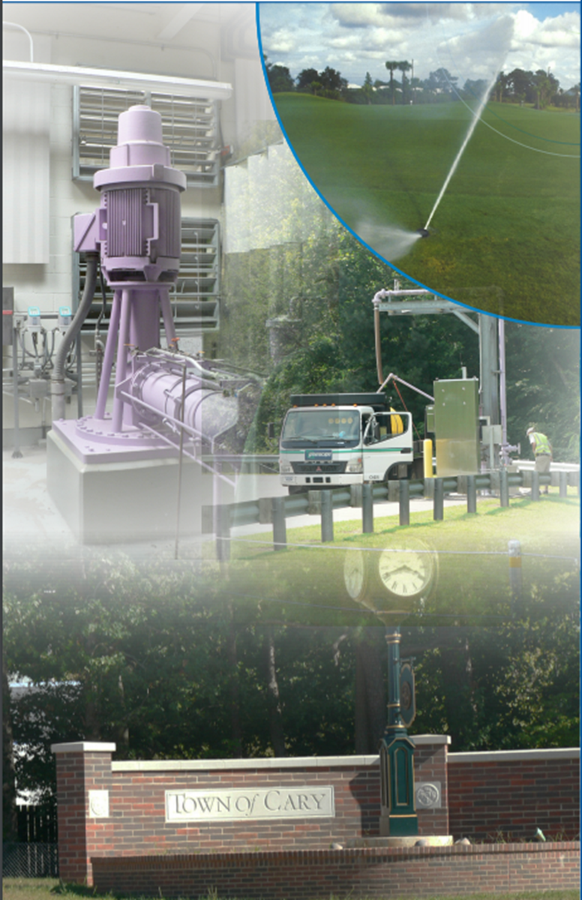
Town of Cary
Reclaimed Water
Environmental Management Commission
Water Allocation Committee Meeting January 8th, 2020
Donald Smith, Wastewater Collection System Manager
Rick Jordan, Reclaimed Supervisor
Town of Cary

Slide 2
Today
What is Reclaimed Water?
Cary’s Story
History/Drivers
Use/Planning
Challenges
Successes
Regulatory View
Challenges
Opportunities

Slide 3
Key Takeaway’s
Ideally demand is year-round & near source
Irrigation is less than originally anticipated
Regulated as “Resource” can encourage use

Slide 4
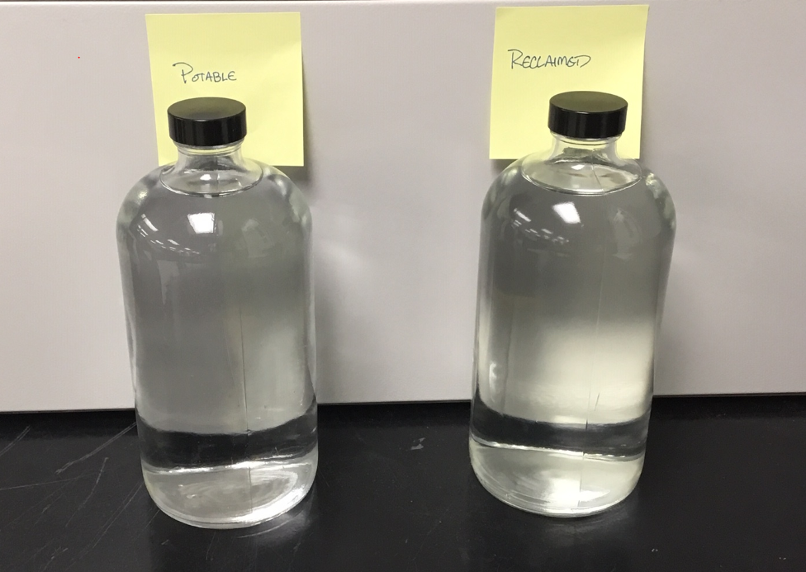
What Exactly is Reclaimed Water?
Highly treated wastewater
(ultraviolet light and liquid chlorine)
Potable
Reclaimed
Clear, colorless, and odorless
Not grey water
Non-potable

Slide 5
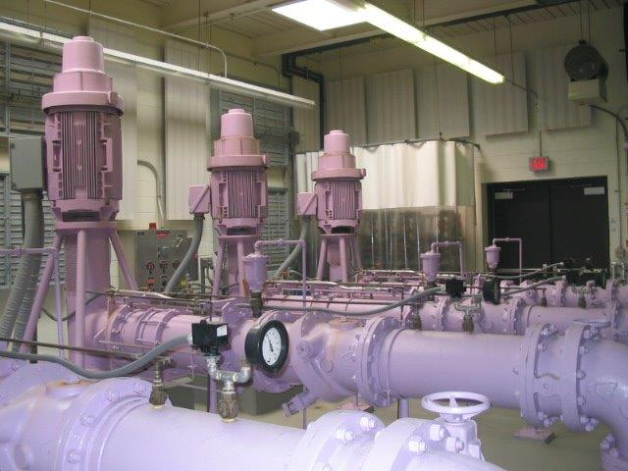
Cary’s History
Began in 2001
Service Areas
Started with nearby residential customers & businesses
System Expansion
Funded through Development & Capital Improvements
Regional Partnerships
Durham County
Wake County RTP

Slide 6
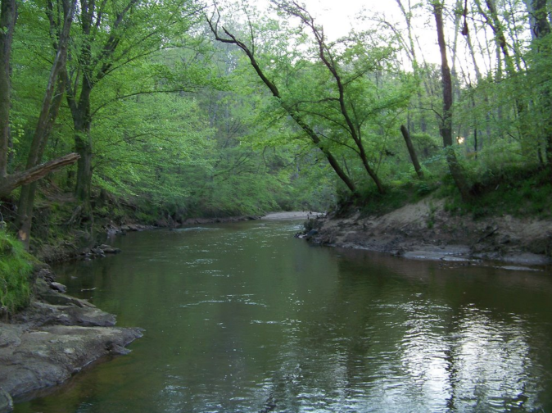
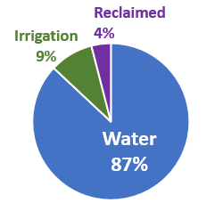
Drivers
Reduce WWTP Nutrients Discharge
Off-set Peak Potable Demands (Irrigation)
Expand Service Portfolio for Customer Benefit
Customer Drivers Policies & Incentives

Slide 7
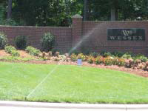
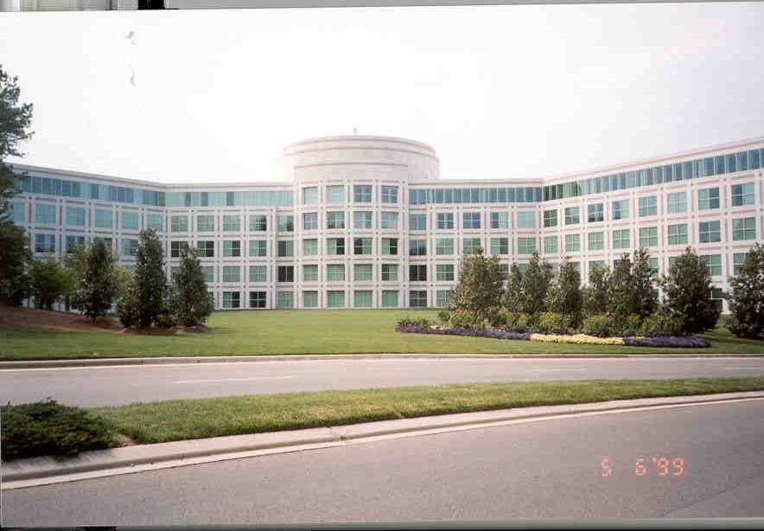
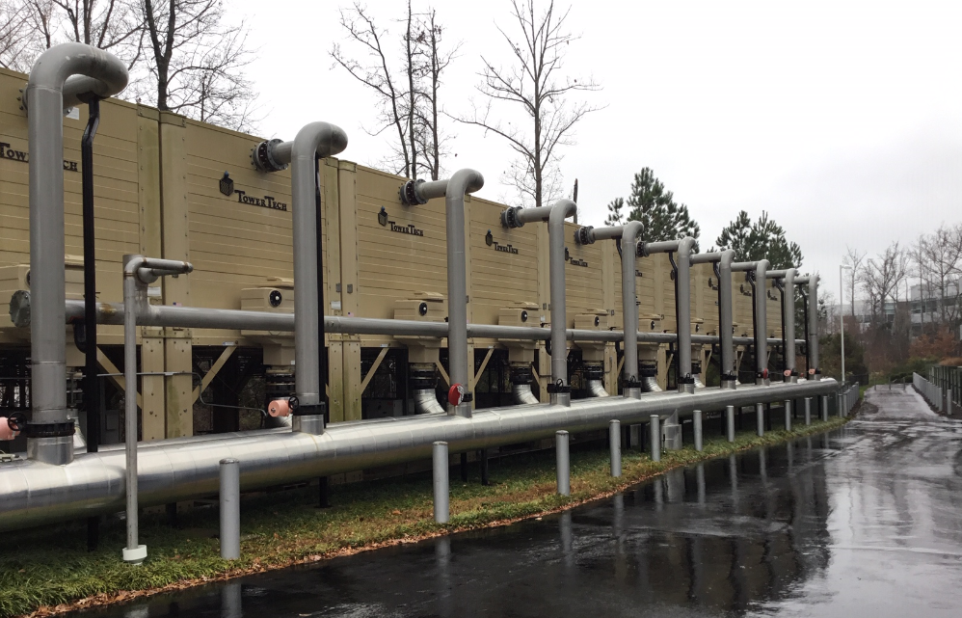
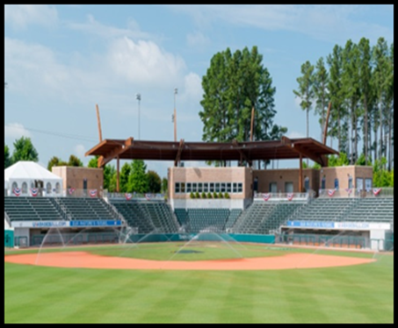
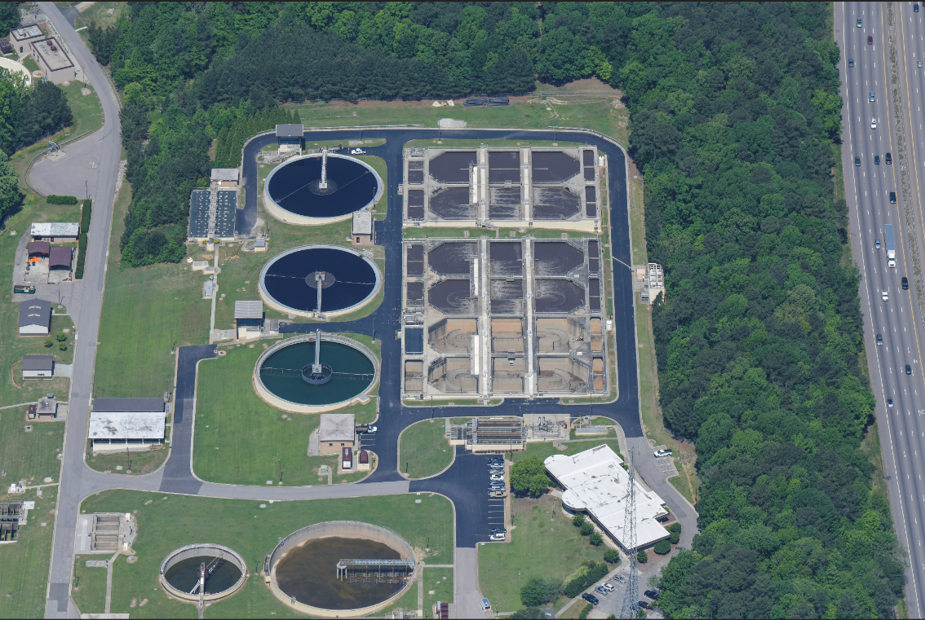
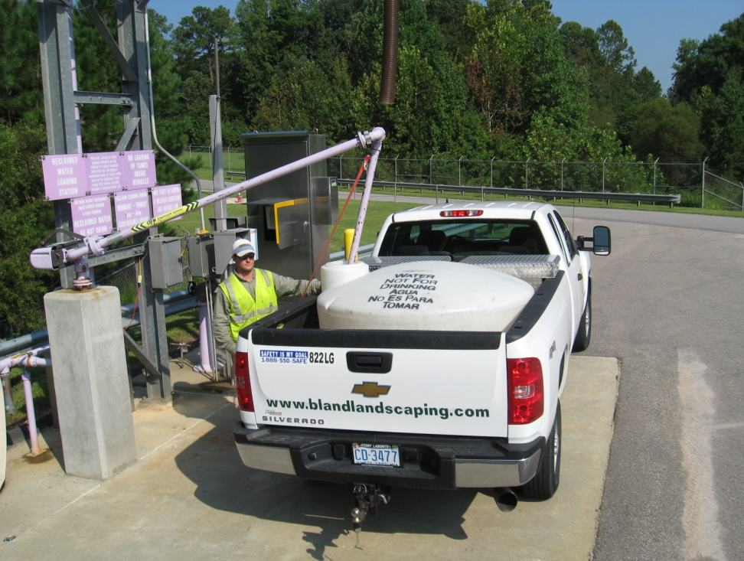
How is Reclaimed Water Used in Cary?
Commercial/Industrial
Cooling Towers
~60 miles of pipe
~800 Customers
Mainly Residential Irrigation Customers
Process Use at 3 WRF
Irrigation: Residential
WRF Process Use
Bulk Distribution
Irrigation: Commercial & Recreation

Slide 8
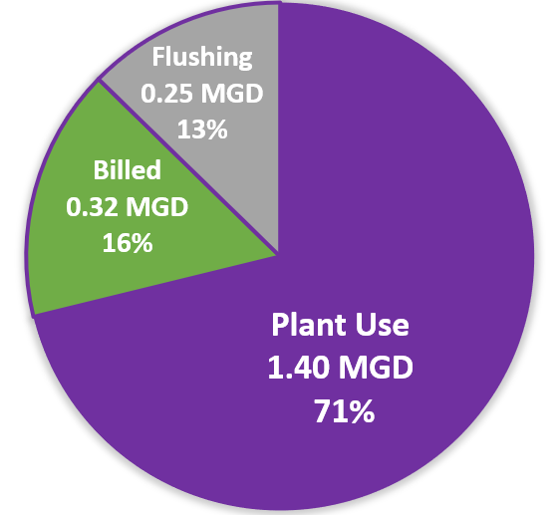
Where It’s Used?
Ideally demand is year-round & near source
Irrigation is less than originally anticipated

Slide 9
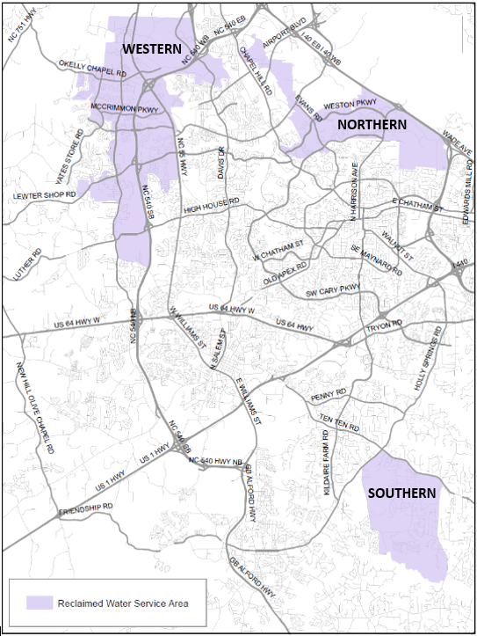
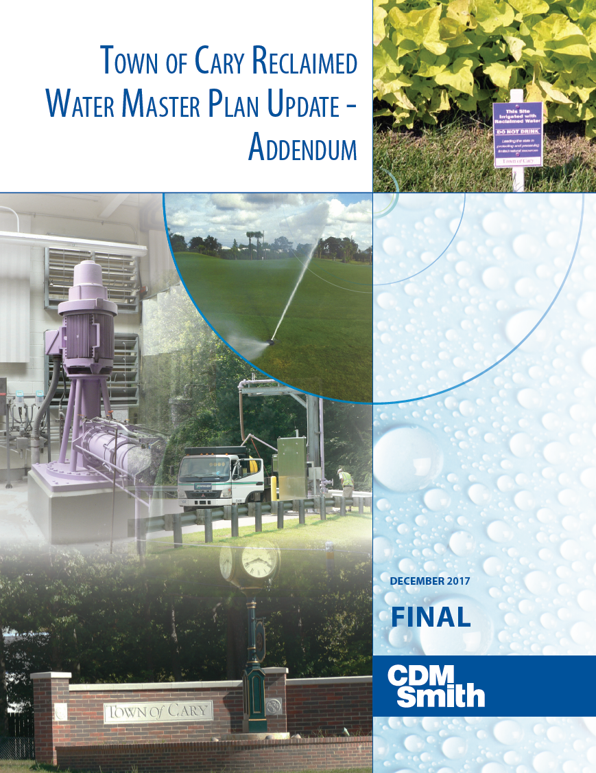
Plan Iterations
2001 – Original Policy Statement
2007 – Master Plan
2013 – Revised (MP)
2017 – Revised (MP)
2018 – Re-evaluate Services Area
2019 – Revise Service Area
Reclaimed Service Areas (July 1, 2019)

Slide 10
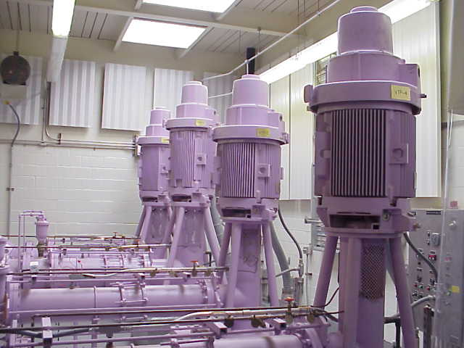
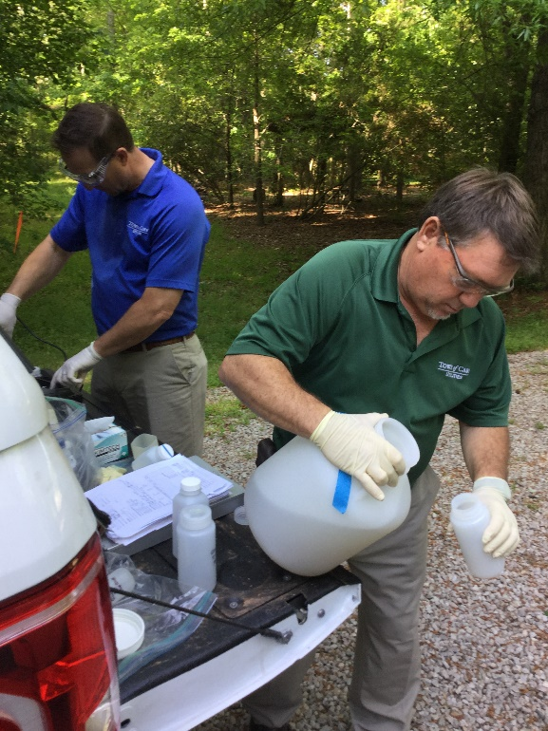
Program Management
Operation & Maintenance
Pumps & distribution piping network
Chlorine residual
Monthly compliance sampling
Annual maintenance shutdown
Education & Outreach
Development Support
Plan Review
Inspections

Slide 11
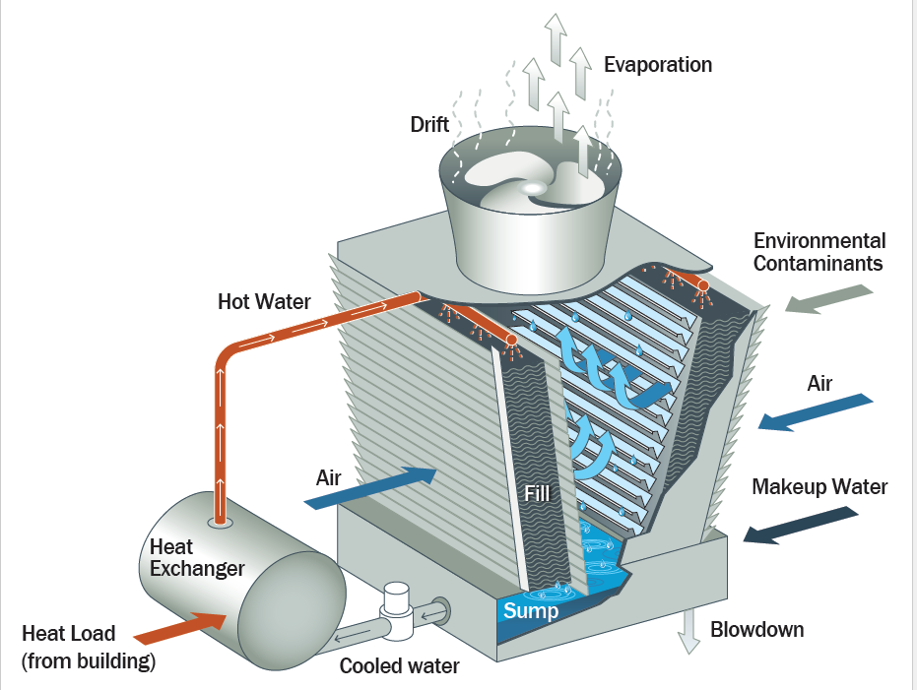
Operational Challenges
Seasonal Use
Requires flushing during low-demand
Water Quality for Cooling Tower Use
Requires supplemental WQ management
Concentrated blow-down to sewer
System Maintenance
Gets more complex with increasing size (tanks, chlorine boosting, more flushing)

Slide 12
Successful Partnerships
RTP Project
Providing RCW to a Business Campus
Interlocal Agreement
Regional Collaboration

Slide 13
Is it a Waste or a Resource?
Administrative Code NCAC 15.02U interprets
reclaimed as a “waste not discharged”
Regulatory interpretation has a significant impact
Reframing it as a resources could encourage use

Slide 14
Regulatory Challenges & Opportunities
Reporting
Required to report any overwatering or leaks
Handled like a sewer overflow, even on private property
Flushing
Essentially required to blow-off to sewer system
Consumed WRF capacity and has already been treated
Future Applications
Indirect potable reuse

Slide 15
Key Takeaway’s
Ideally demand is year-round & near source
Irrigation is less than originally anticipated
Regulated as “Resource” can encourage use

Slide 16
Questions?

